Slide 1
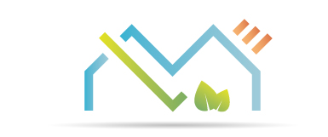
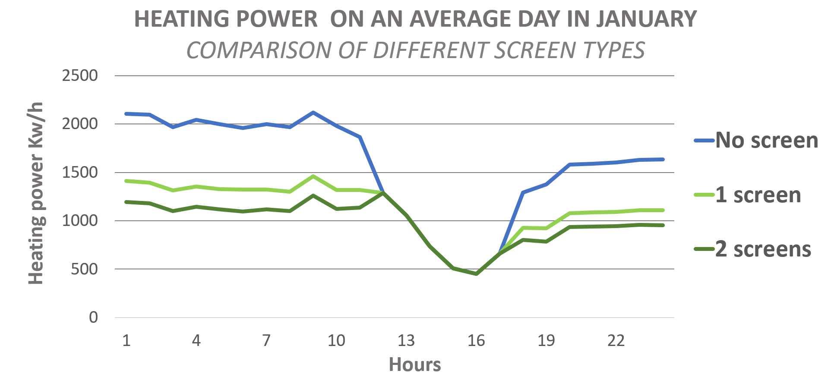
Hortinergy
online software to design energy efficient greenhouse
Vincent Stauffer, vincent@hortinergy.com
CEO, Hortinergy
Notes:
Présentation produit : Compare > Find > Reduce

Slide 2
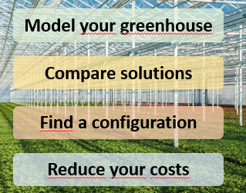
Hortinergy: a friendly online software to design greenhouse
You can simulate all over the world:
  Greenhouse type
    Glass, plastic
    Classic, semi closed, closed…
  Equipment (screen, pad & fan)
  Climate setpoints same as a climate computer
  Assimilation light (LED, HPS)…
  For several crop: tomato, cannabis…
Outputs: hourly simulation for a typical year
  Inner climate
  Energy consumption : heating, cooling, deshu…
  Scenarios comparison
  -> define the best investment

Slide 3
Input form

Slide 4
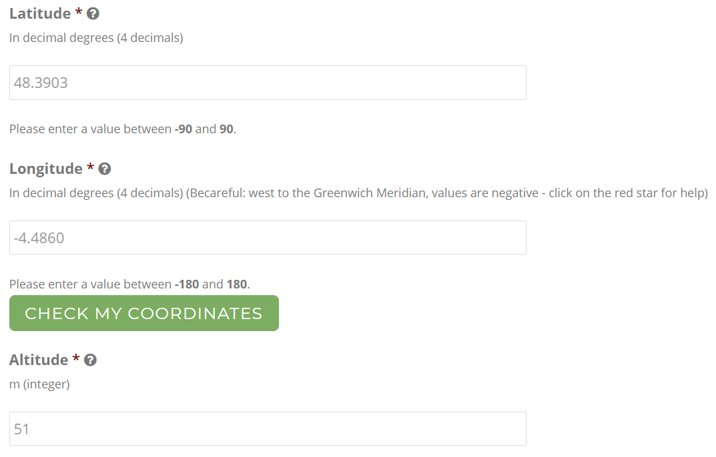
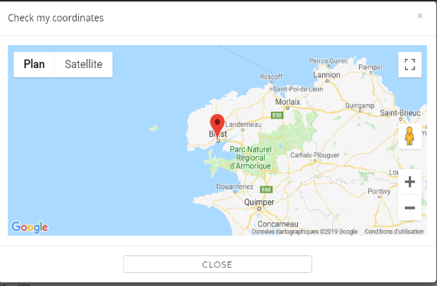
Location of your greenhouse
-> Generate a weather file

Slide 5
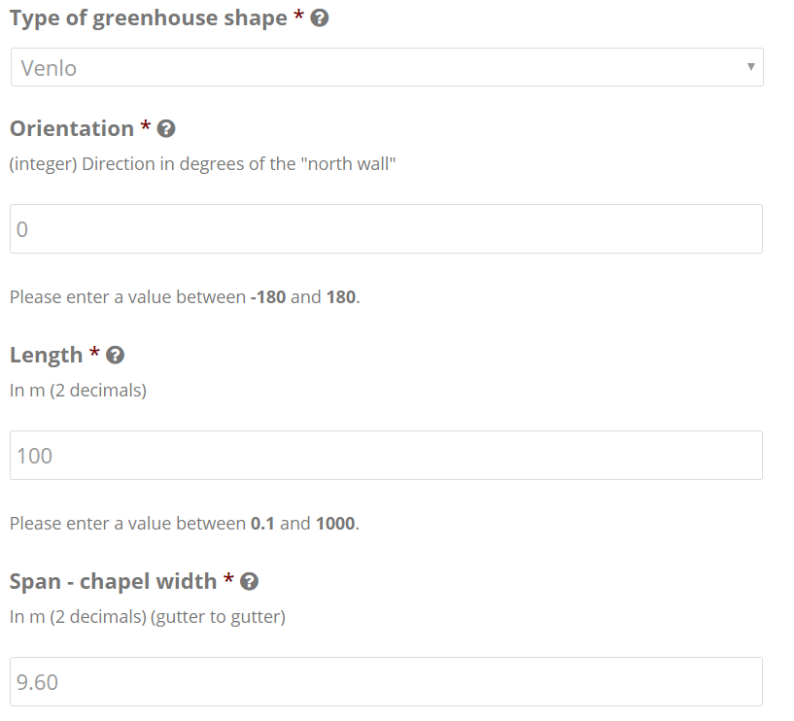
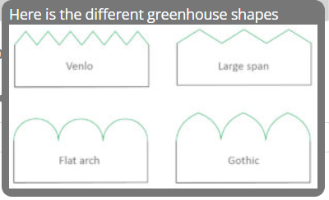
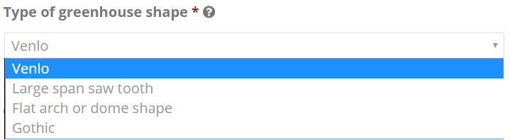
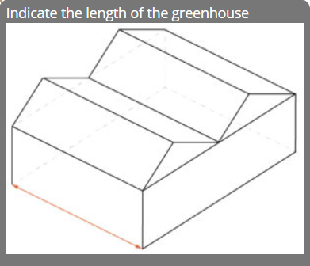
Characteristics of your greenhouse
Type
Dimensions

Slide 6
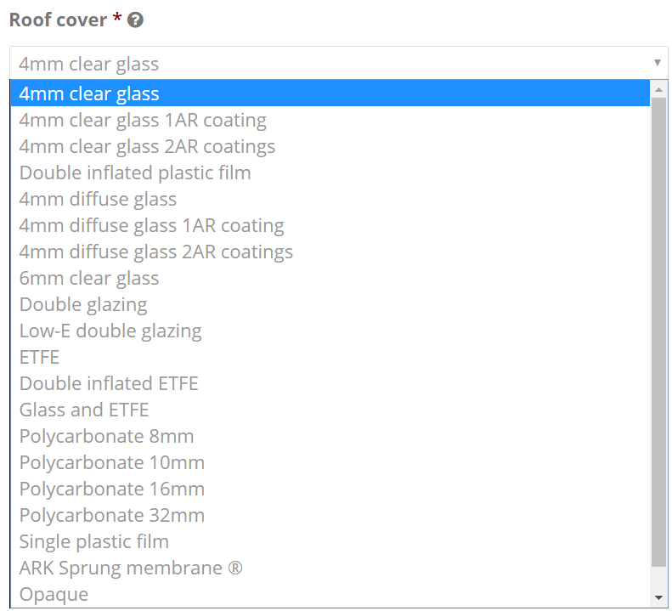
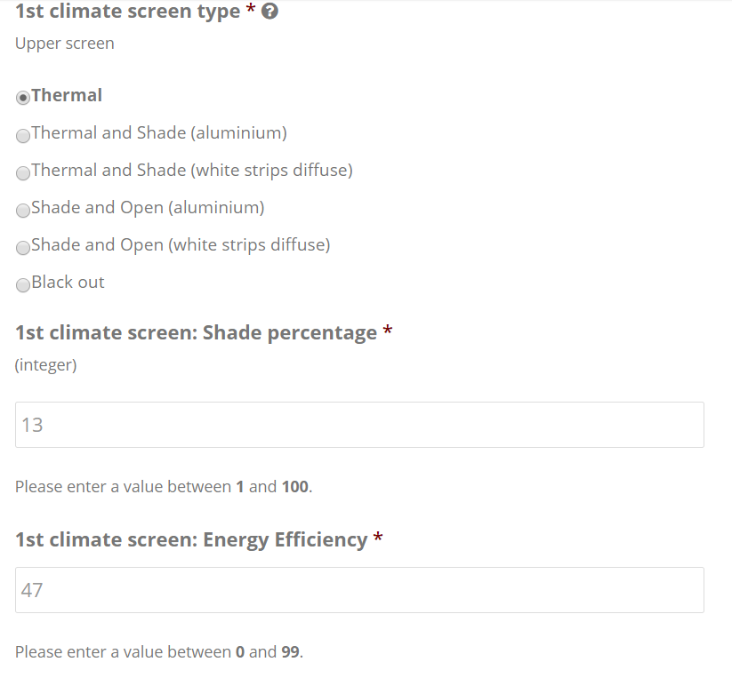
Cover and screen
Screen selection and specification
Cover selection in a library

Slide 7
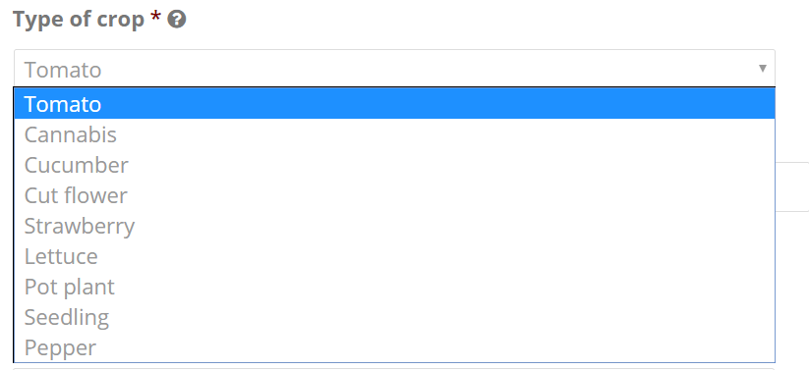
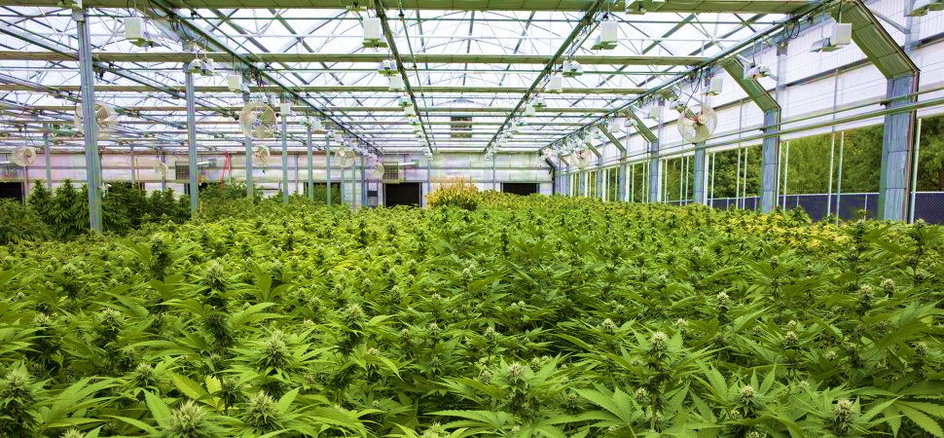
Crop selection
-> Crop transpiraton calculation

Slide 8
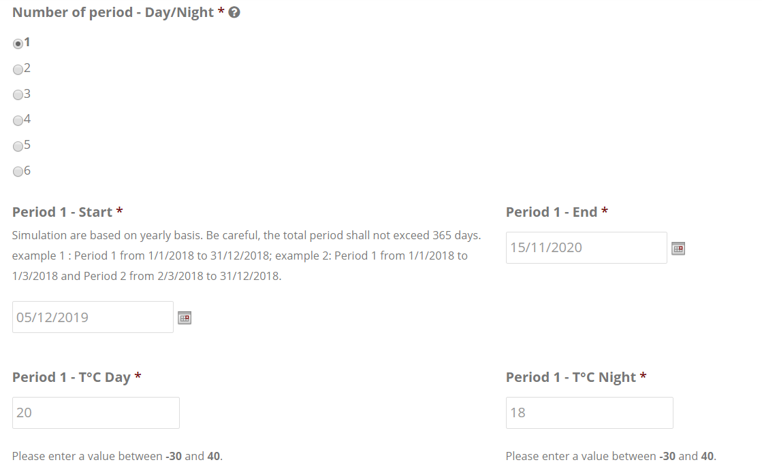
Climate settings
Same settings as a climate computer:
Temperature set points: heating, cooling
Humidity: relative humidity or humidity deficit
Screen regulation
Assimilation lighting (DLI, PAR..)

Slide 9
Other features
Semi closed greenhouse
Closed greenhouse
Pad & fan
Fog
Assimilation lighting
Heating and buffer tank
Greenhouse gas emission

Slide 10
Report

Slide 11
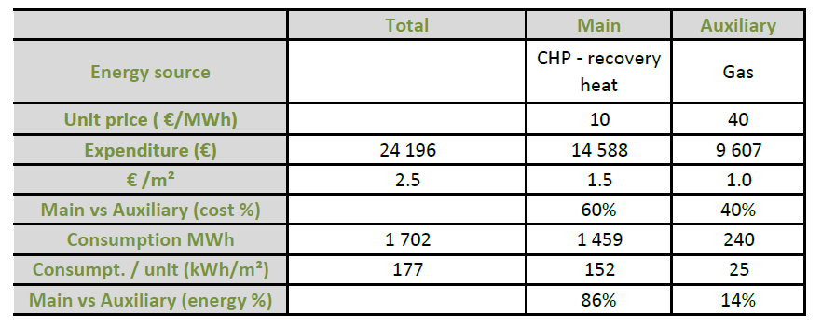
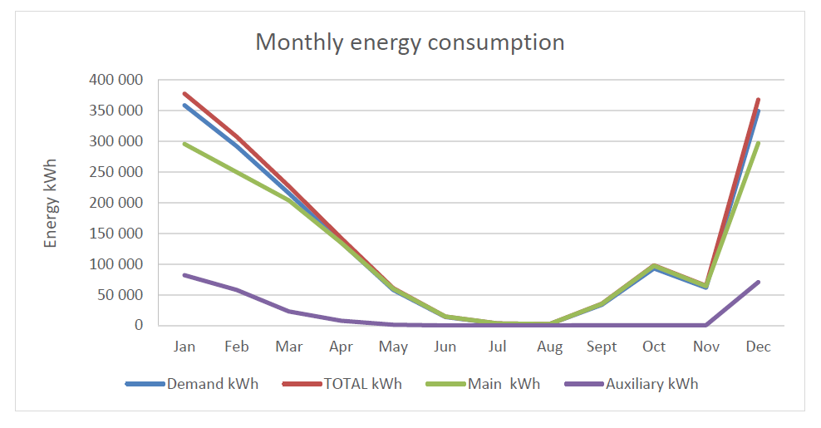
Energy consumption
Annual overview: energy consumption and expenditures
Monthly detail

Slide 12
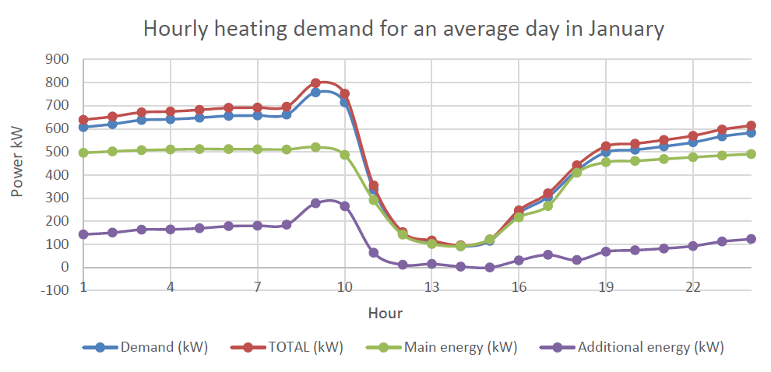
Hourly heating demand
You can see the heating demand of your greenhouse for a typical day each month

Slide 13
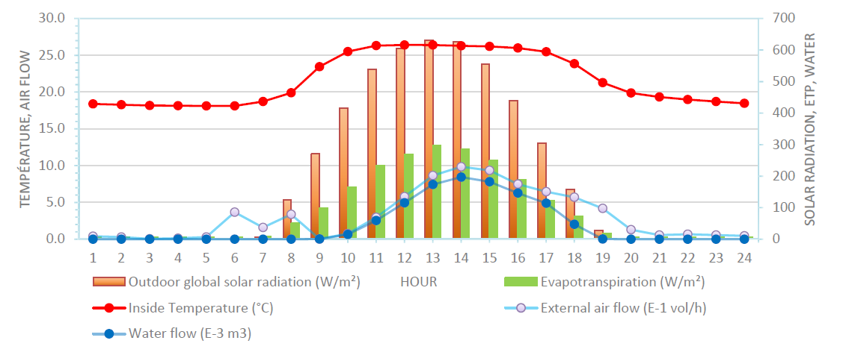
Indoor climate simulation
Indoor climate for typical days for different months

Slide 14
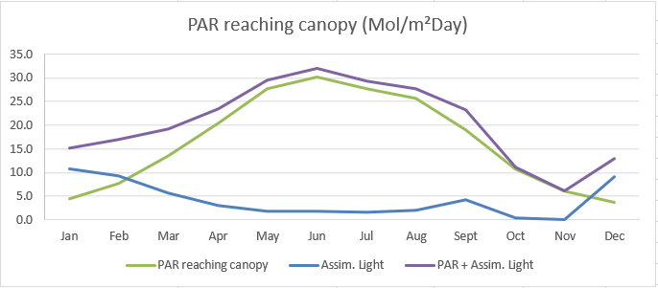
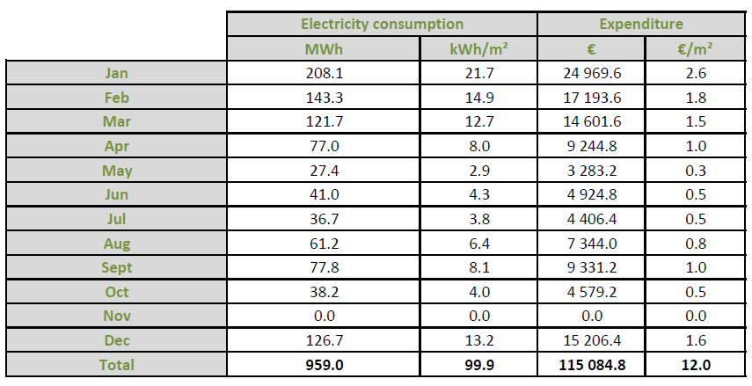
Light
Solar radiation and assimilation light reaching the canopy

Slide 15
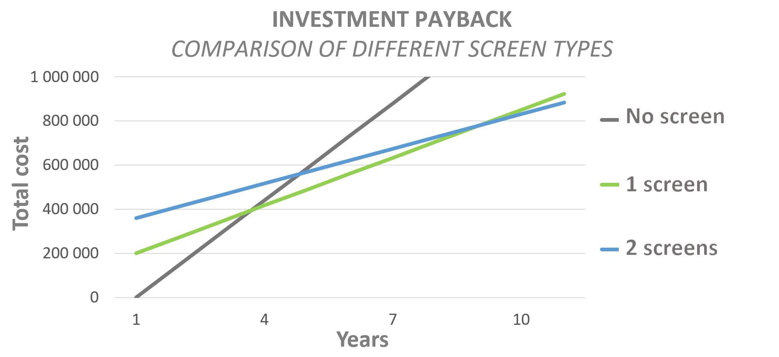
Scenarios comparison
-> choose best configuration

Slide 16
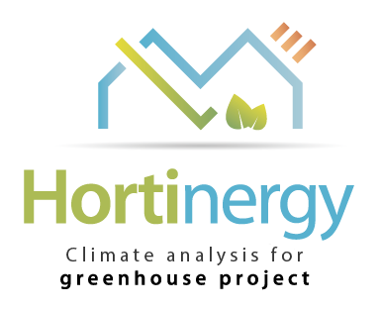
Thank you
Check our website HORTINERGY.COM
contact@hortinergy.com

